Slide 1
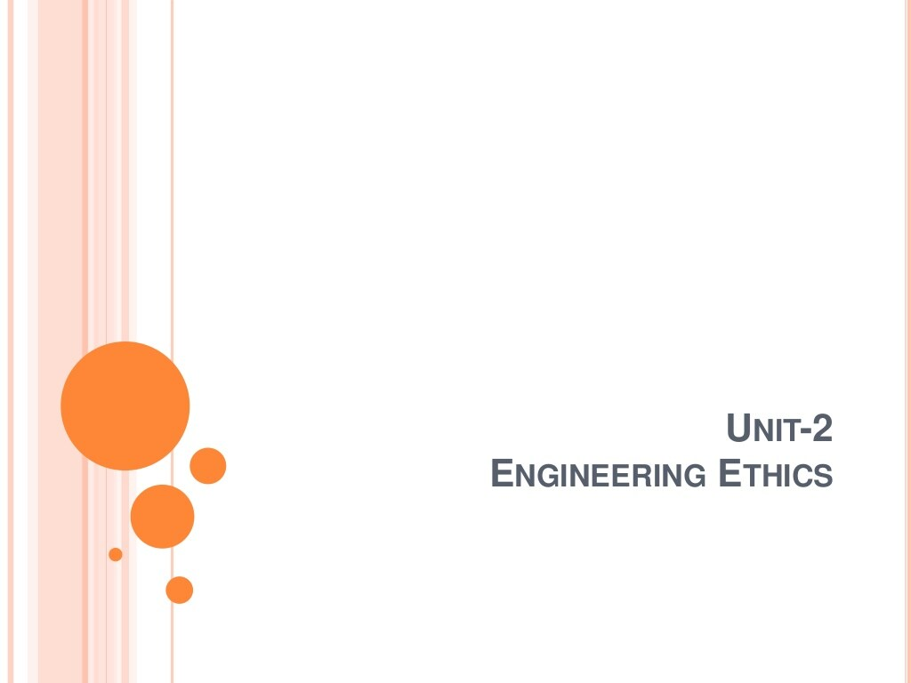
Uses of Ethical Theories
Vivek Garg
CSVTU Bhilai

Slide 2
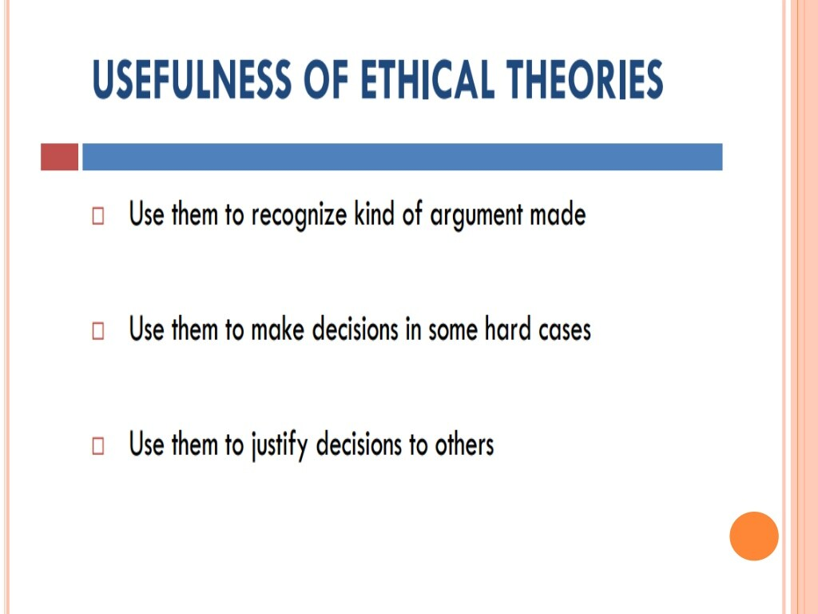

Slide 3
